Slide 1
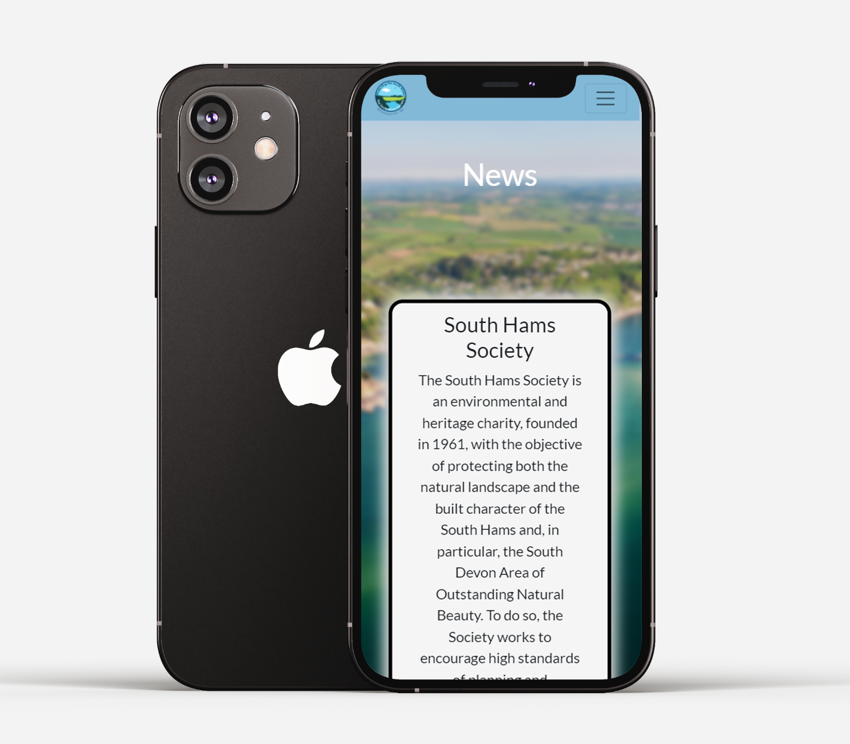
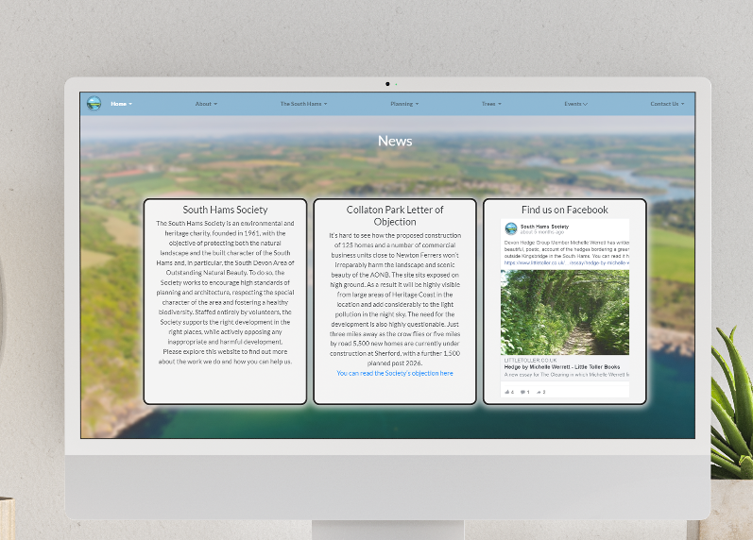
COMP2003
Group B
South Hams Society Website
Final Presentation
Thomas Philpott
Harry Parker
Oliver Donnellan
James Rudd
INDEX.HTML

Slide 2
Overview of this presentation
/01
Objectives
/02
Where we were previously
/03
Content management
system
/04
Live Demo!
Outline the objectives that we listed to aim for with this project
Describe the progress from past meetings
We’ll show you how the CMS works
Showcase our project
INDEX.HTML

Slide 3
/01
Objectives
YOUR LOGO HERE
INDEX.HTML

Slide 4
Main Objectives of this Project
Design:
Ensuring that the website has cross-device functionality, so it functions properly on phone's as well as computers.
Improving the flow of the website so users have no problem with navigating
Testing that the design is accessible to all users is a big factor, such as ensuring text readability for users who are visually impaired
Improving the Society’s Membership:
Design the form to be:
Digital - with no mandatory choice to download and print off form
Convenient and easy to understand - When signing up to websites - forms can be often difficult to understand/use so we want to make it easy for everyone.
INDEX.HTML

Slide 5
/02
Where we were previously
YOUR LOGO HERE
INDEX.HTML

Slide 6
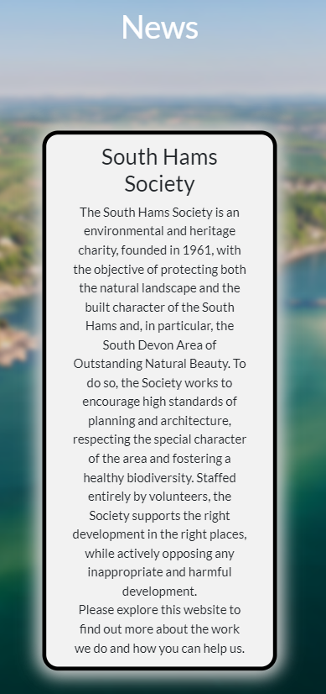
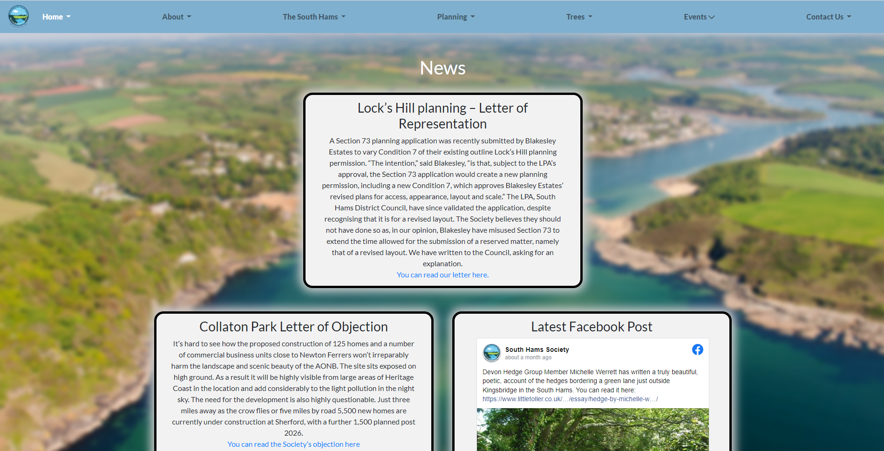
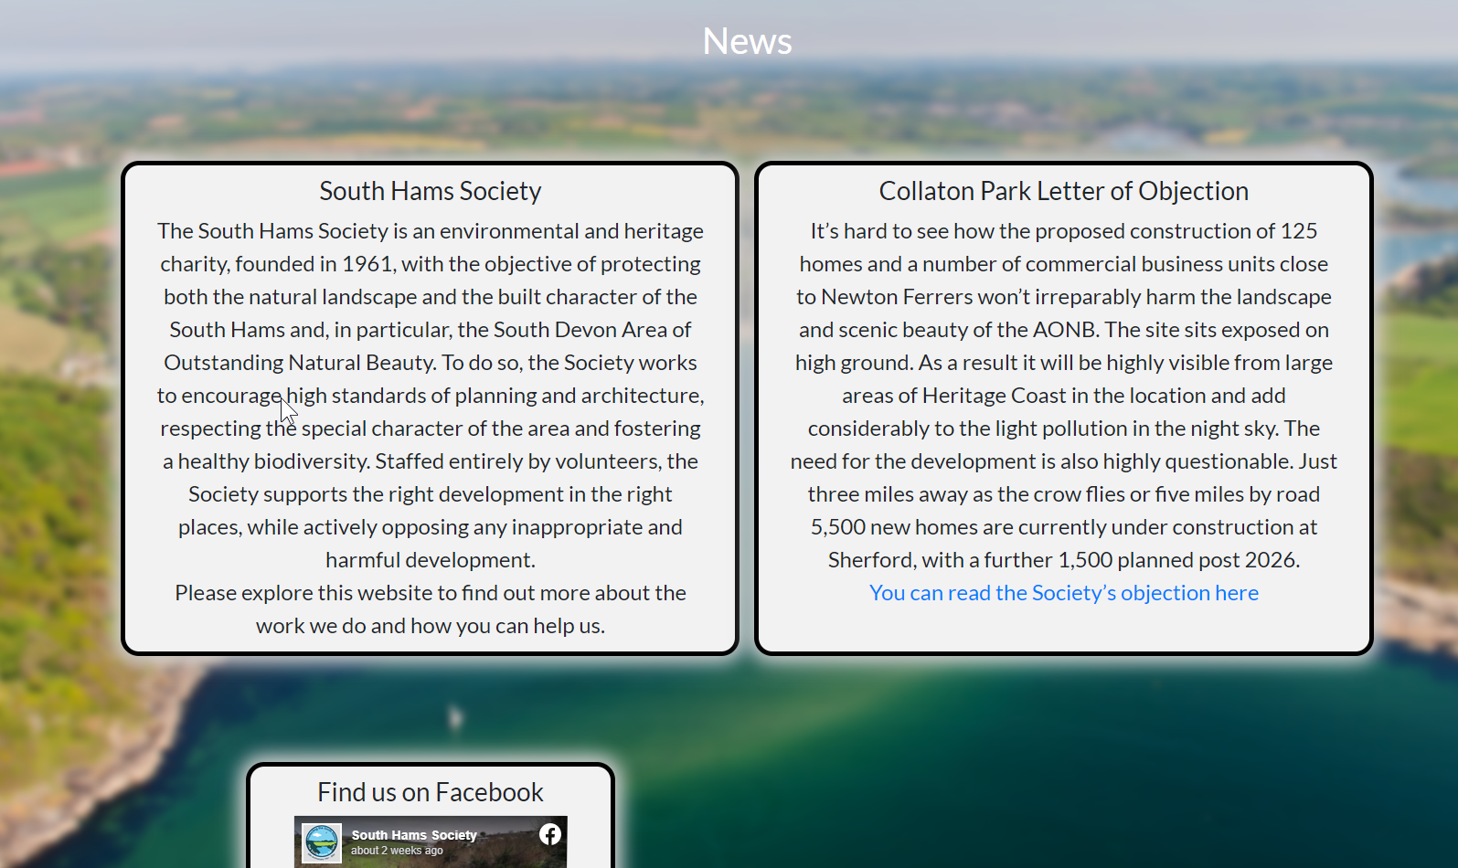
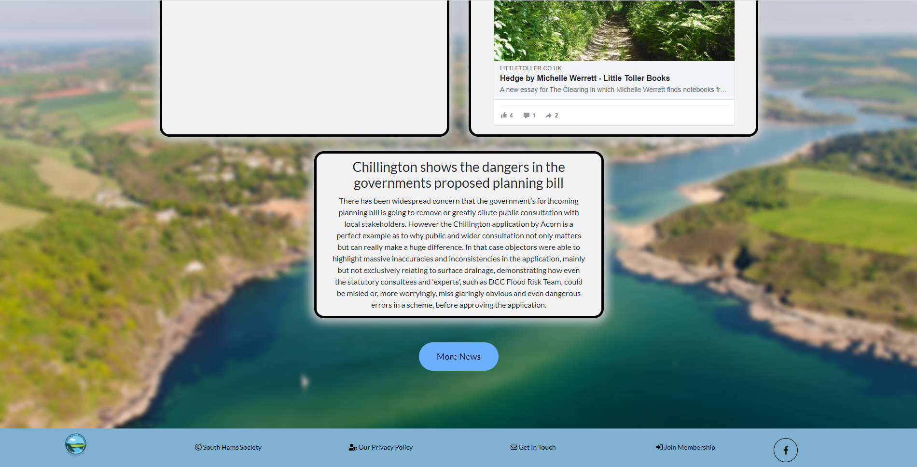
Some key pointers we took from the last demonstration:
We took the front-end design feedback into account, and redesigned the front-end to match the client’s requirements:
The front index page consisted of a diamond shaped layout with one text box in the top row, a textbox and a facebook box in the second row, and finally a single text box in the bottom row.
This was improved by taking the client’s feedback of turning it into a grid system, so on large screens there will be less rows, however on mobile screens there will be single rows for each box so the content can fit and flow on a smaller screen.
Before:
After:
INDEX.HTML

Slide 7
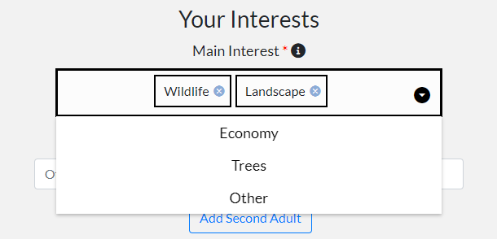
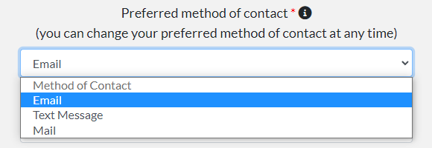
More front-end changes:
Some more re-designs were made based on the client’s feedback. For example:
An email address input was added to the family membership form as it is important contact information that may be required.
An option for interests was added, which consist of tags that can be selected through a dropdown menu
An option for selecting the preferred method of contact can also now be selected
INDEX.HTML

Slide 8
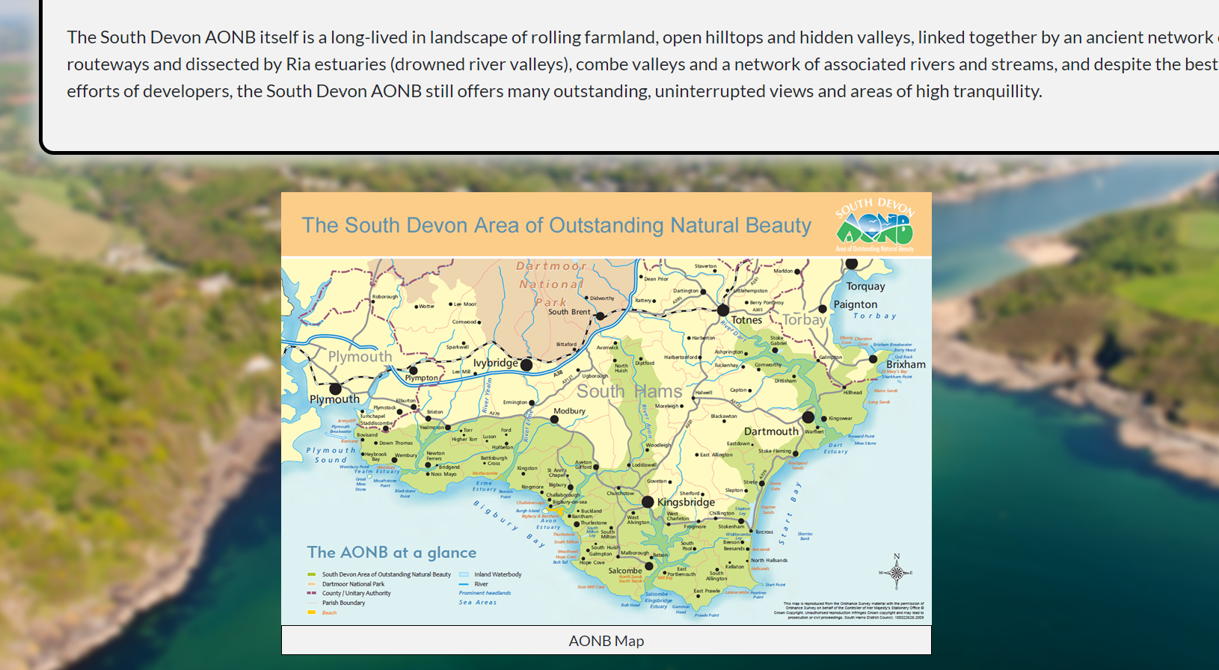
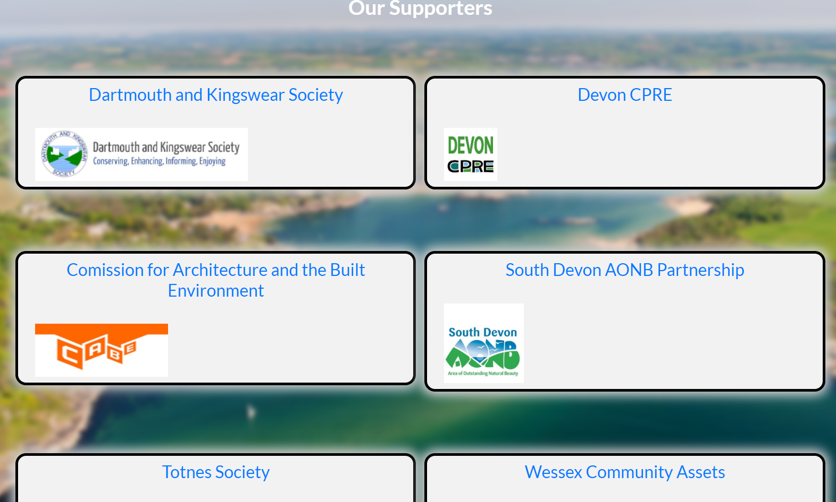
Other examples of design improvements include:
A map image of the AONB
A page displaying the supporters of the South Hams Society
INDEX.HTML

Slide 9
/03
Content management
system
YOUR LOGO HERE
INDEX.HTML

Slide 10
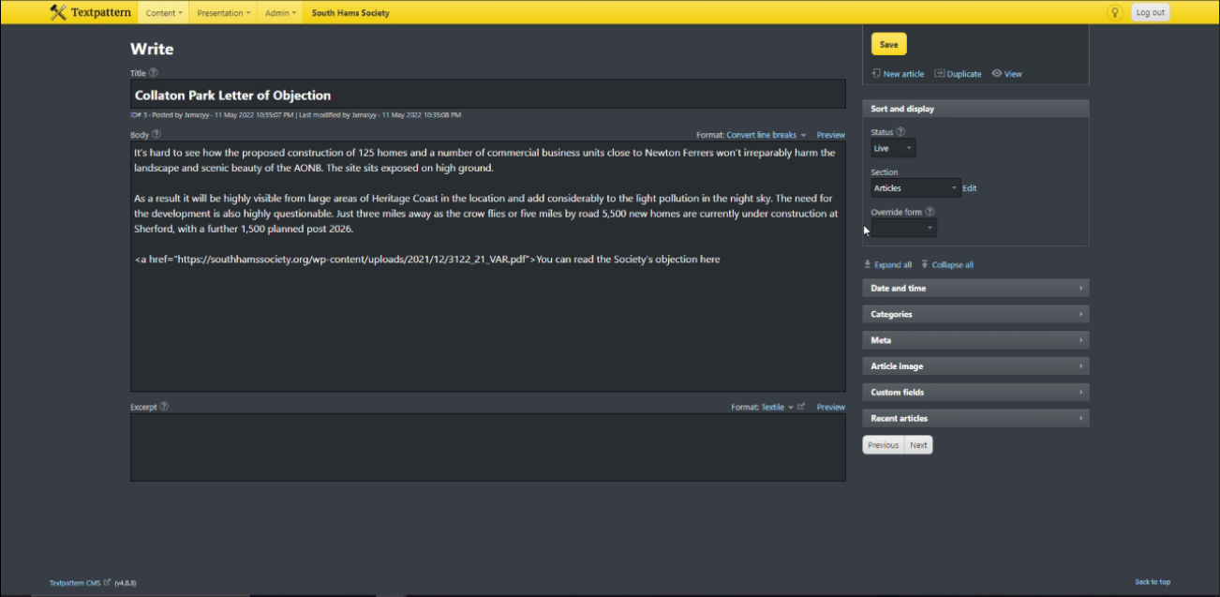
For content management, we decided to use Textpattern:
The already created pages are being converted for the CMS.
Textpattern includes a range of free platform modifications, plugins, and themes. Which has allowed us to implement the original pages into the CMS.
The site allows easy authoring for articles on each page.
Easy to use interface.

Slide 11
/04
Demo!
YOUR LOGO HERE
INDEX.HTML

Slide 12
THANKS!
DO YOU HAVE ANY QUESTIONS?
INDEX.HTML

